Slide 1
Git Extension
Powered by:Hossein Rahmatizadeh
Winter 2012

Slide 2
What is this?!
Git Extensions is a toolkit to make working with Git under Windows more intuitive

Slide 3
Install:
For VS 2012 ,2010 users:
it is recommanded to install it within Visual Studio by selecting Tools | Extension Manager.
Run Visual Studio.
Go to Tools | Extension Manager, search online gallary for Git Source Control Provider and install.
For VS 2008 users :
download and run Installer for VS 2008

Slide 4
Features of V.1.0.0
Add support to use Visual Studio's diff window
Prompt user to save files before commit
Prompt user to set name and email for git, if not already
Pending Changes commit not showing hooks errors/messages (by Javier Castro)
Support bulk file deletion
Use new icons for git and git extensions
Allow commit of selected changes via Ctrl+Enter
Automatically save items when refreshing

Slide 5
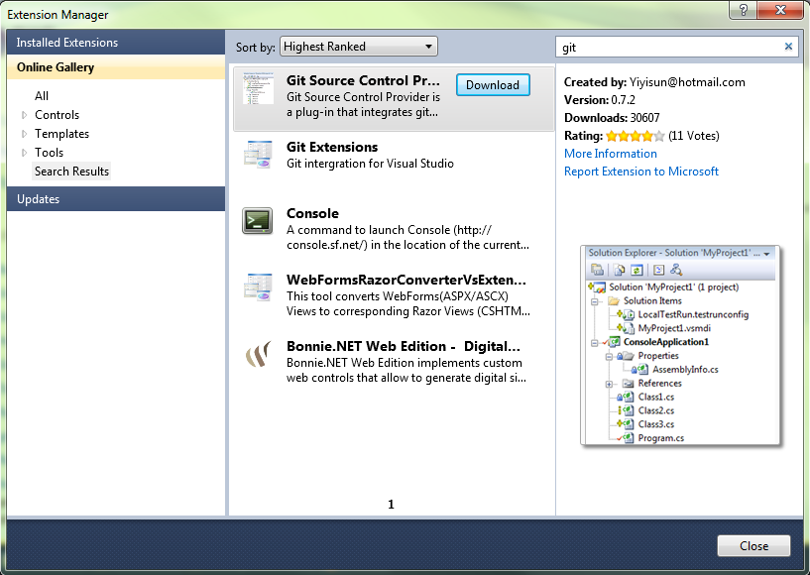
Installing:
Step 1.
Launch Visual Studio, Select menu Tools | Extension Manager,
Search online gallery for Git Source Control Provider .Download and install.

Slide 6
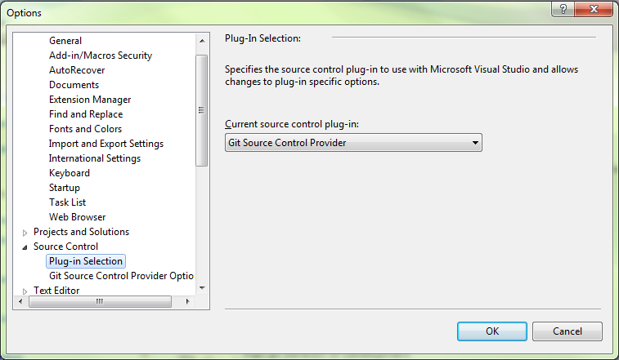
Step 2.
Go to Tools | Options.
Select Source Control in the tree view
Select Git Source Control Provider from the drop down list, and click OK.

Slide 7
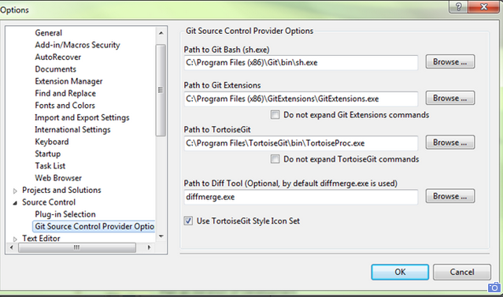
Verify the paths to your favorited git tools are setup correctly.

Slide 8
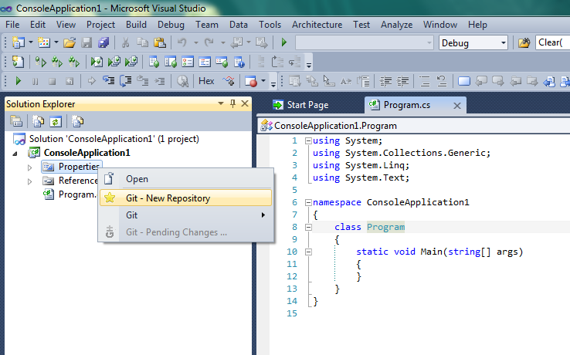
New Repository
To create a new Git repository, right click the project in the solution explorer and select menu "Git - New Repository".

Slide 9
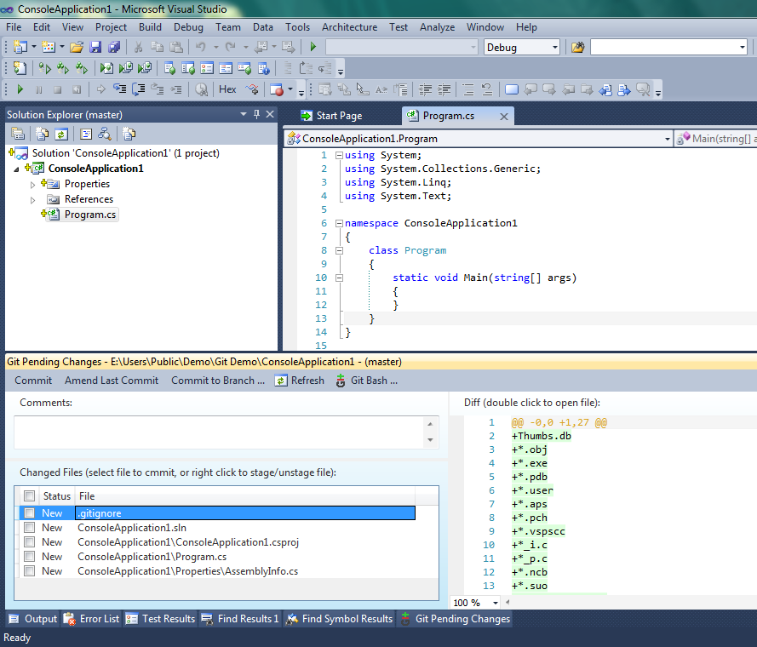
The files status are shown as new files. The .gitignore file is also created automatically.

Slide 10
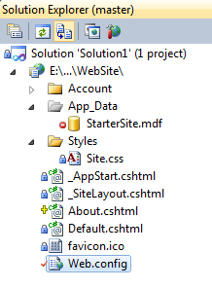
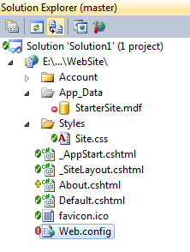
Style:
Git Source Control Provider displays file status in Visual Studio's solution explorer. It has two styles, the traditional (VSS/TFS) style and TortoiseGit style.
traditonal style TortoisGit style

Slide 11
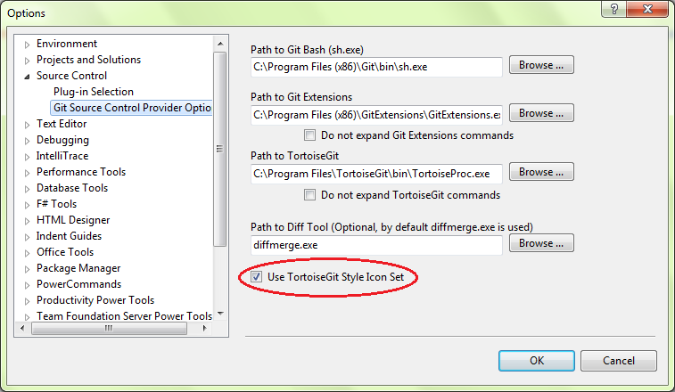
Change style:
The the traditional (VSS/TFS) style is the default. By using the Git Source Control Provider options page, under menu Tools | Options, you can choose to use the TortoiseGit style.

Slide 12
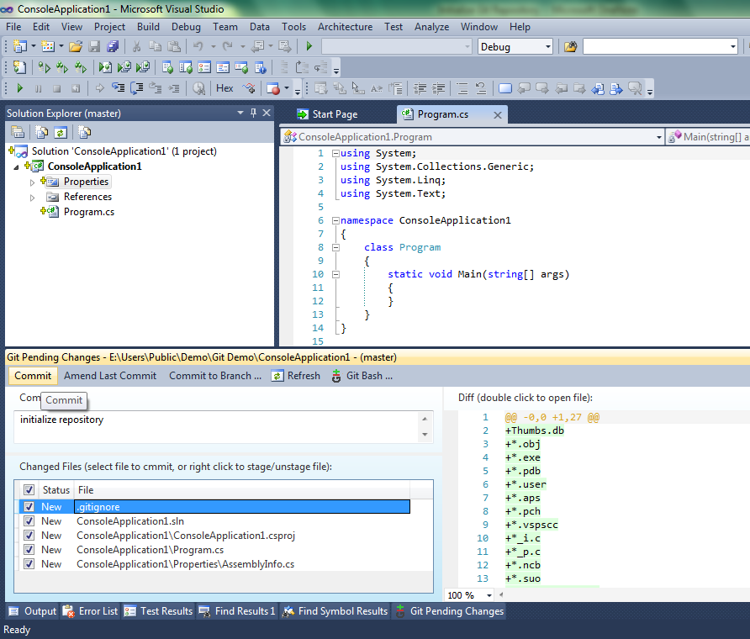
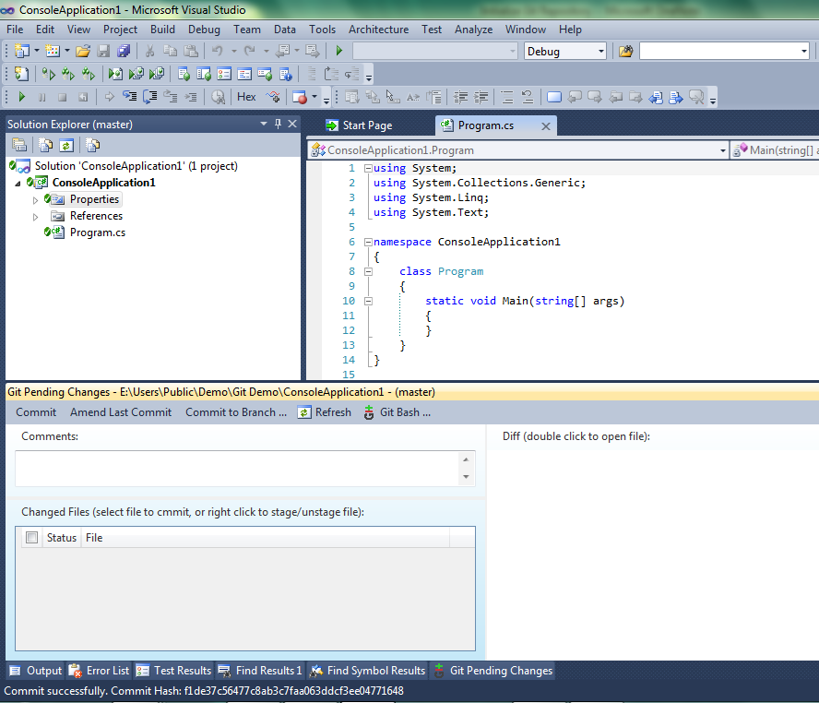
Commit:
right click the project in the solution explorer and select menu "Git"
New, modified and deleted files are shown in the Changed Files list.
Select the files you want to commit. The diff view on the right side shows the details of what has been changed compare to last commit.
Add comment message and click the “Commit” button.

Slide 13
Any Question?!

